Slide 1
Promoting Literacy in the cte classroom
What in the world does teaching (insert class you teach here) have to do with teaching reading?

Slide 2
The Reading tutor
The Reading Tutor

Slide 3
Reading in CTE
Reading is critical to building knowledge in all disciplines.
Career ready reading requires an understanding of domain specific words and phrases, an attention to detail, and the ability to follow detailed descriptions of concepts or events.
The vast majority of reading in workforce training programs will be sophisticated informational text.

Slide 4
Using reading levels to guide instruction
Leveled informational text
Newsela
Article of the Week
Vale Middle School Informational Text Rubric
Notes for struggling readers
Small group instruction/learning stations

Slide 5
Formative assessment tooLs
Plickers
Plickers are FREE! Plickers are quick and easy!
Kahoot!

Slide 6
resources
Plickers
www.plickers.com
Newsela (Leveled Articles)
https://newsela.com
Article of the Week
http://vms.vale.k12.or.us/articles-week
Simplifying articles or other text
https://rewordify.com/
If anyone has any questions on how to use or implement any of these resources in the classroom, don’t hesitate to e-mail at hebertn@chebschools.org

Slide 7
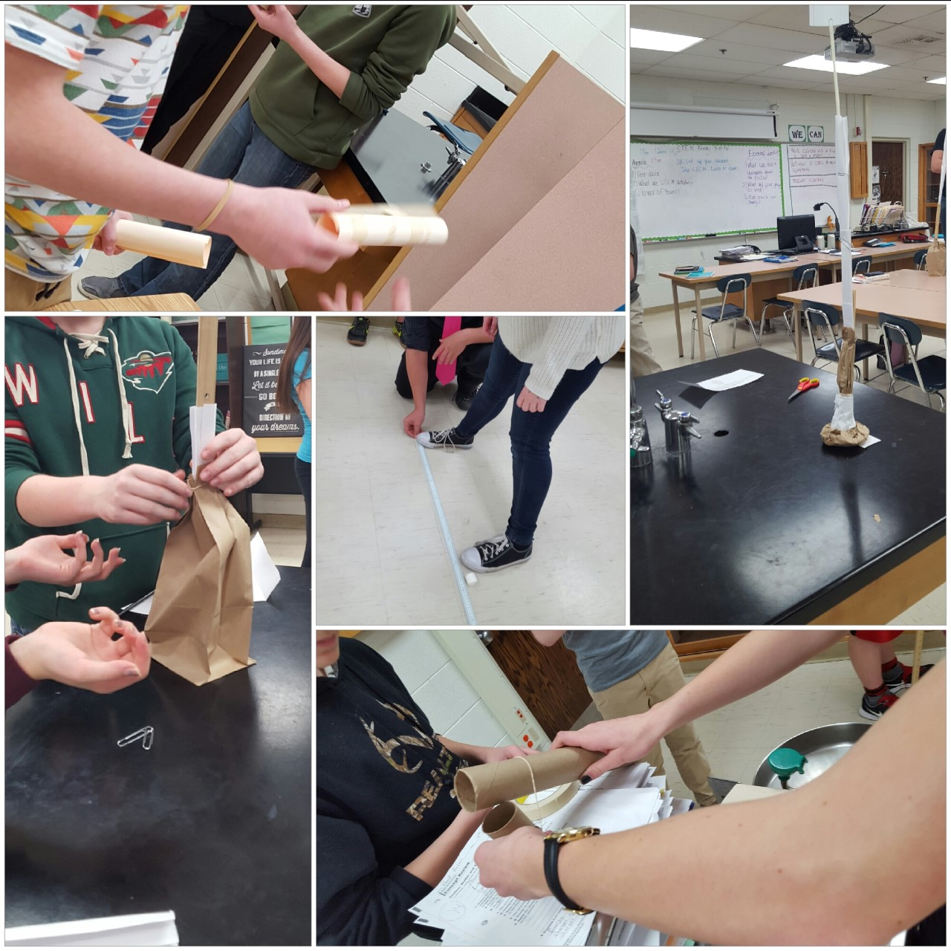
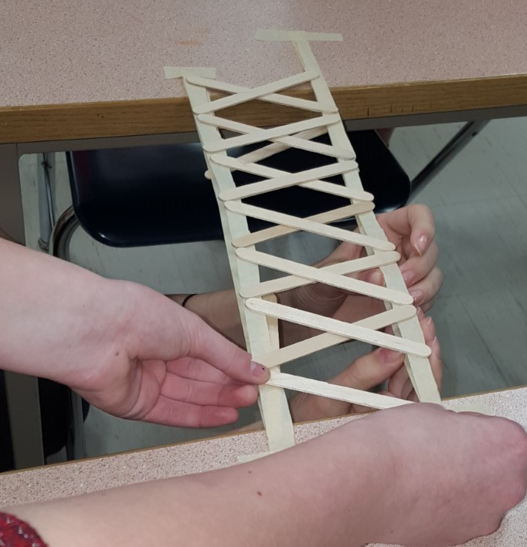
STEM FRIDays

Slide 8
Contact Information
hebertn@chebschools.org
231-627-7191

